Slide 1
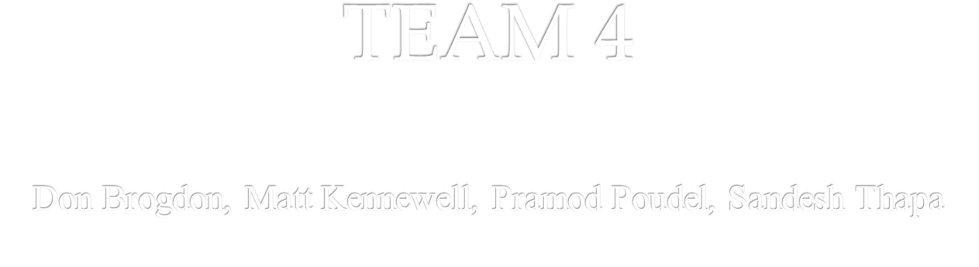
BMT Database Design

Slide 2
AGENDA :
Brief description of BMT database
The entities and relation between it.

Slide 3
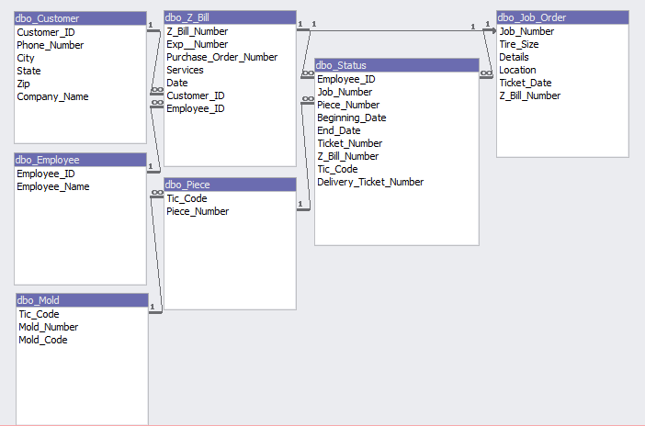
Relationships

Slide 4
Entities
Customer
  We decided this to be entity because customer place an order and deals with the financial transaction.
Z-Bill
  Z-Bill is the key identifier which provide the detailed information what services need to be performed.
Employee
  A employee that works for the company .

Slide 5
Z-Bill
Job Order
  A document that contains detailed information concerning a specific job.
Mold
  A piece of equipment that is used to create different tire pieces depending upon the size.
Piece
  Piece is also important because employee keeps the track of it check the status.

Slide 6

First of all we would like to thank Dr. Dave Smith for giving us the opportunity to develop database for BMT. It was a wonderful learning experience for us while working on this project. This project gave us knowledge about the database design and implement sql language. In our project we have use sql, forms and relation for database. We enjoyed each and every bit of work we had put into this project.
Thank You for your patience!!

Slide 7
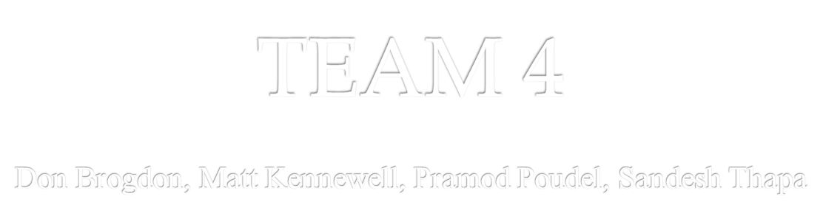
Thank You

